Slide 1
Multi-Label Speech Emotion Recognition Using 2D CNNs
Using machine learning to identify multiple emotions in speech
Brian Pho
BSc Software Engineering
Department of Electrical and Computer Engineering​
Friday, August 23, 2019

Slide 2
Table of Contents
Introduction
Literature Review
Summary of Results
Method
Preprocessing
Neural Network
Results and Discussion
Summary
Limitations and Future Work
Conclusion

Slide 3
Table of Contents
Introduction
Literature Review
Summary of Results
Method
Preprocessing
Neural Network
Results and Discussion
Summary
Limitations and Future Work
Conclusion

Slide 4
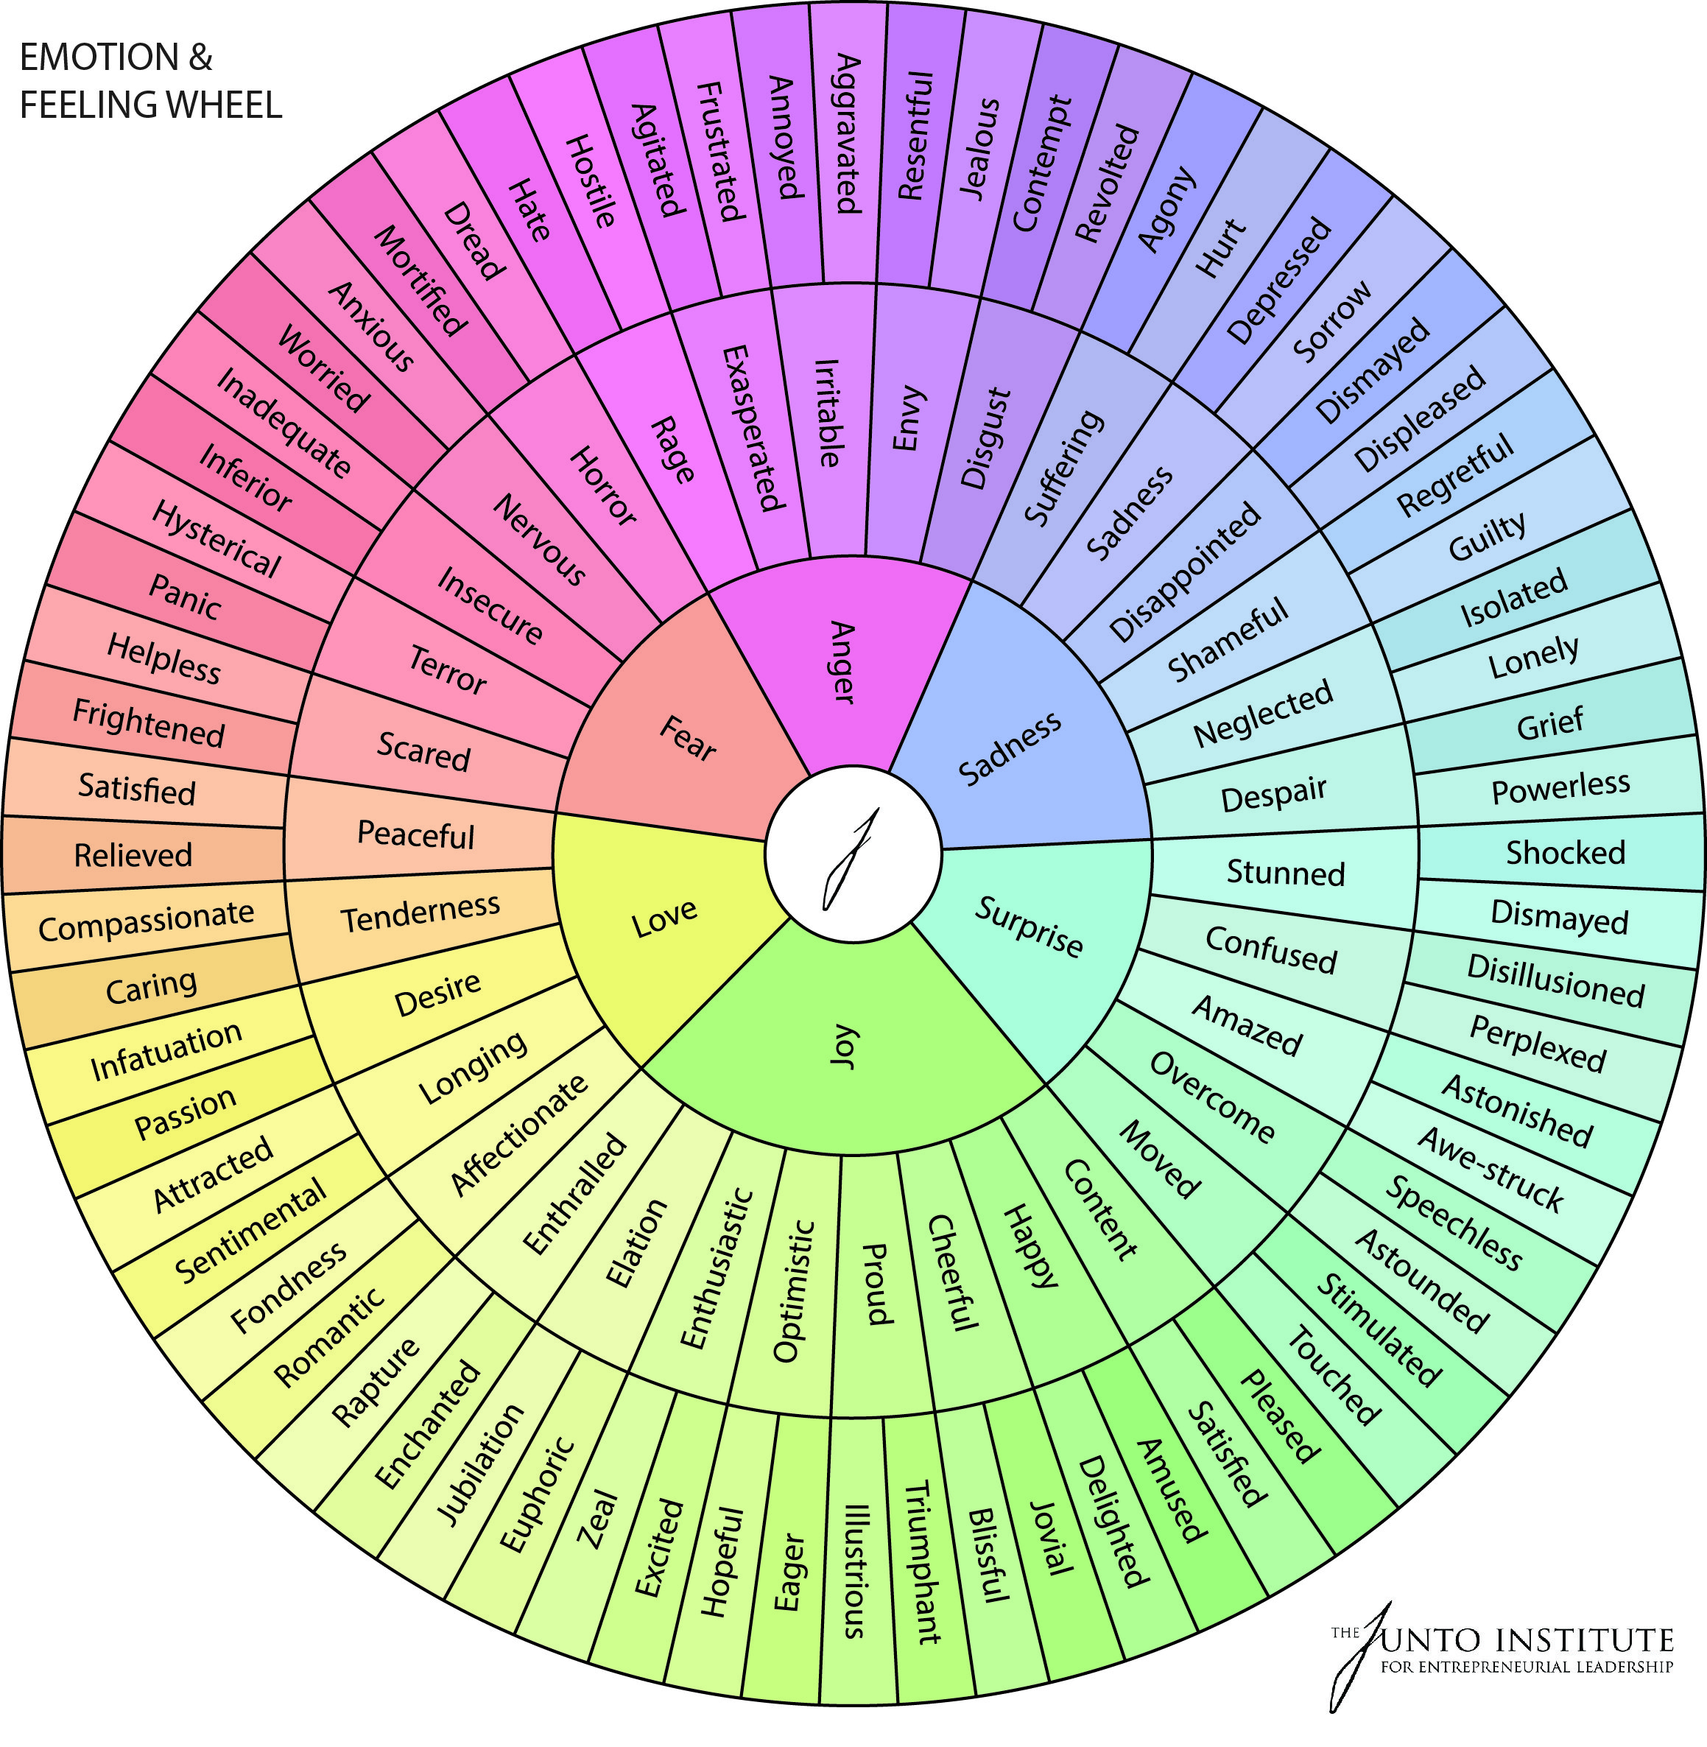
Literature Review – Big Picture
Affective computing
“The study and development of systems and devices that can recognize, interpret, process, and simulate human affects.”
Affect
“The experiencing of feeling or emotion.”
Affective computing has applications in voice assistants, kiosks, healthcare, education, and video games.

Slide 5
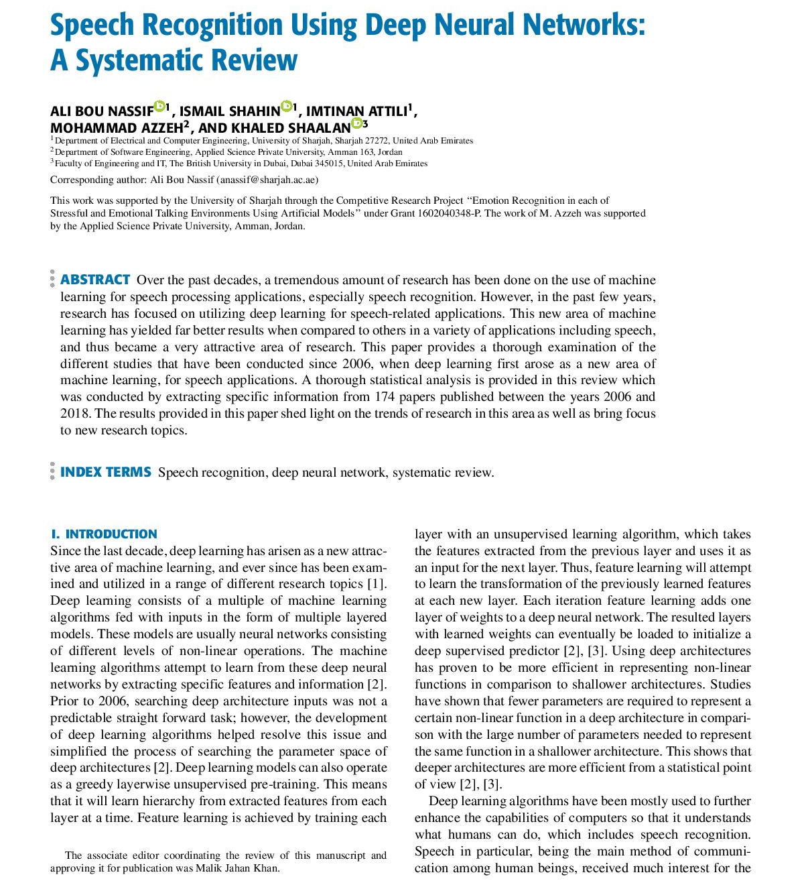
Literature Review – Speech Emotion Recognition
The goal is recognizing which emotions are present in speech.
Two main approaches
Feature engineering (pitch, log energy, MFCC)
Machine learning (CNN, LSTM, HMM)
Machine learning has been the dominant approach for the last 5 years due to how accurate it has been.

Slide 6
Table of Contents
Introduction
Literature Review
Summary of Results
Method
Preprocessing
Neural Network
Results and Discussion
Summary
Limitations and Future Work
Conclusion

Slide 7
Summary of Results
We extend upon current work by
Increasing the number of labels from single to multiple
E.g. From [“happy”] to [“happy”, “surprised”].
Increasing the number of databases the neural network is trained on
E.g. From one or two databases to four databases.
We achieved an accuracy of 52.57% using an eight-layer convolutional neural network trained on four databases.

Slide 8
Table of Contents
Introduction
Literature Review
Summary of Results
Method
Preprocessing
Neural Network
Results and Discussion
Summary
Limitations and Future Work
Conclusion

Slide 9
Preprocessing – Emotions
We considered seven emotions
Neutral
Anger
Disgust
Fear
Happy
Sad
Surprised

Slide 10
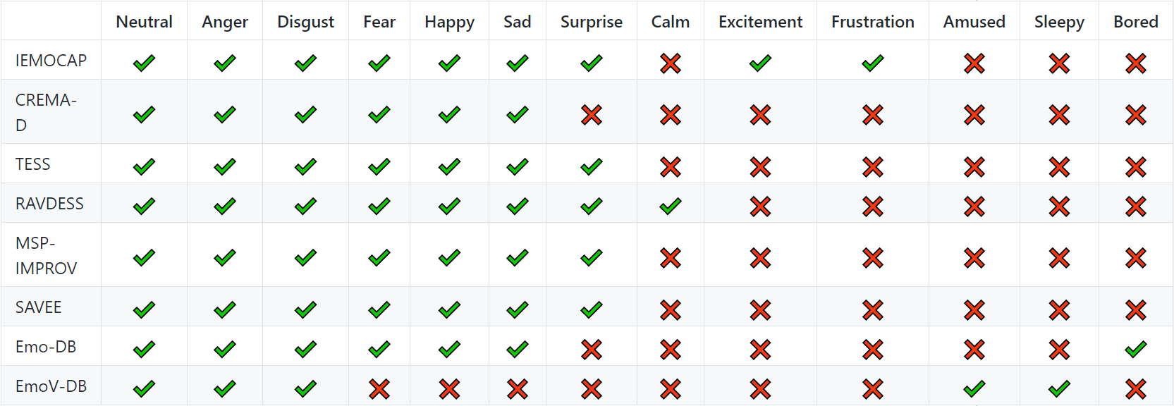
Preprocessing – Databases

Slide 11
Preprocessing – Databases
We used four databases
IEMOCAP
TESS
RAVDESS
CREMA-D
We combined the databases and ended up with 21,675 samples (excluding four and five labels).

Slide 12
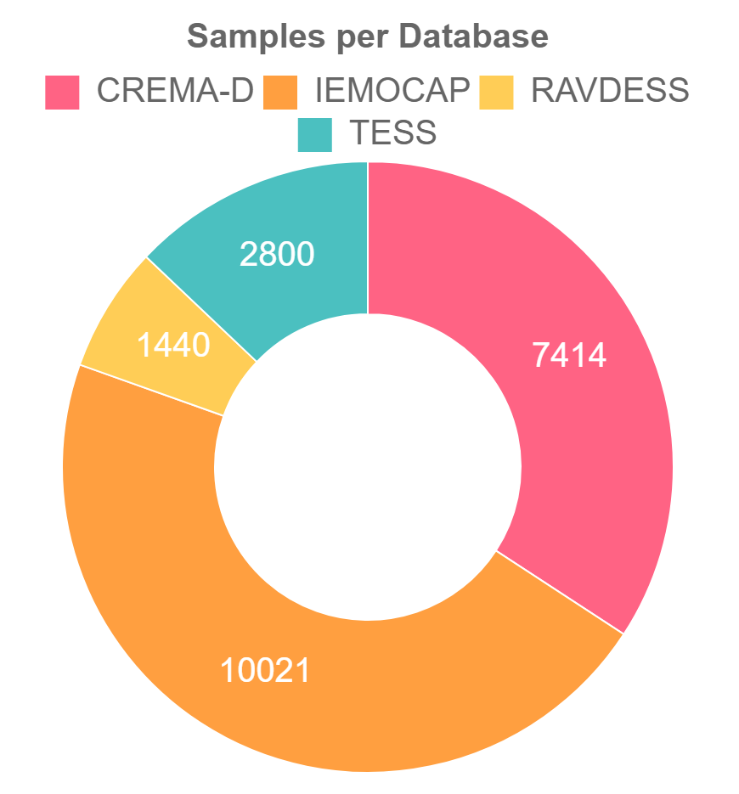
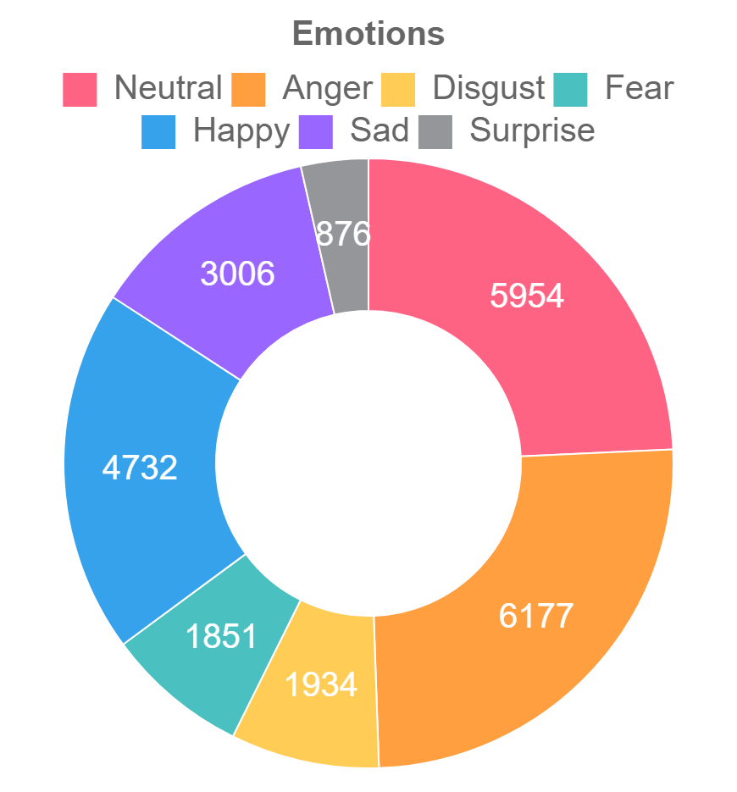
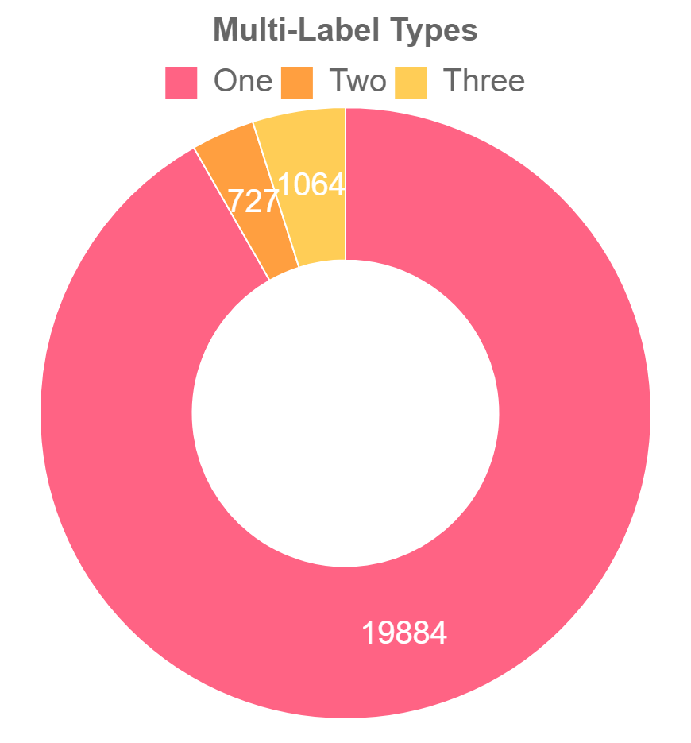
Preprocessing – Combined Database

Slide 13
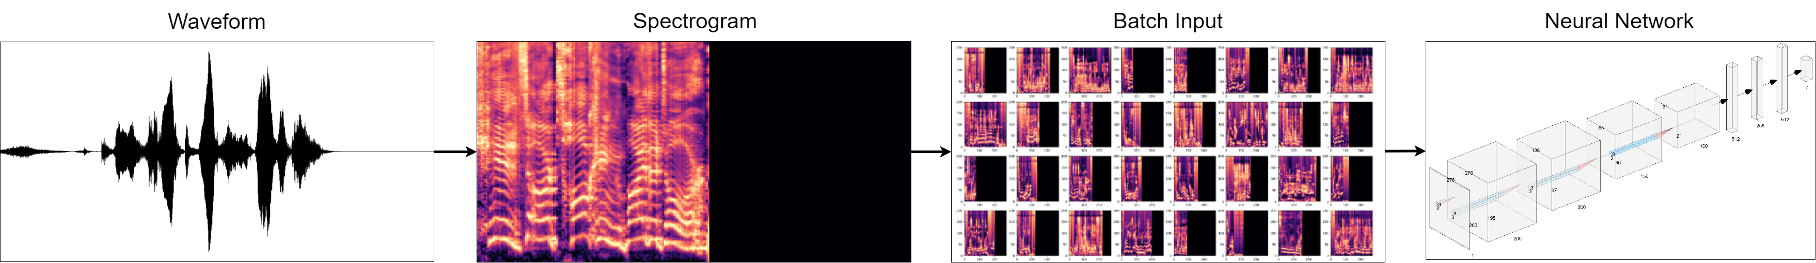
Preprocessing – High Level System Overview

Slide 14
Preprocessing – Processing Samples
Preprocessing steps for audio samples
Raw waveform
Cropped waveform
Padded waveform
Raw spectrogram
Mel spectrogram
Log-Mel spectrogram
Scaled spectrogram

Slide 15
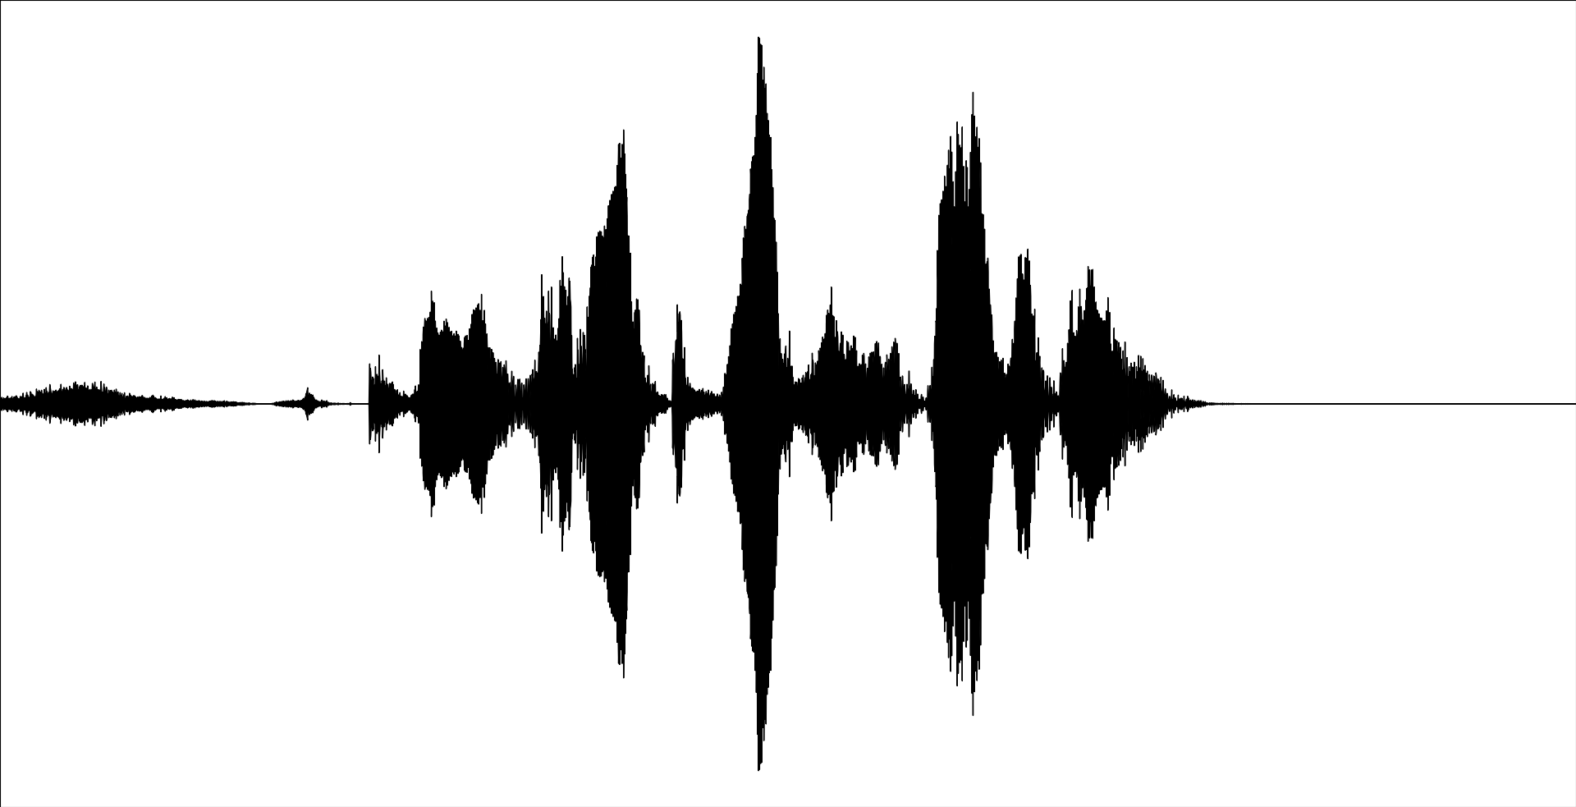
Preprocessing – Step 1. Raw waveform

Slide 16
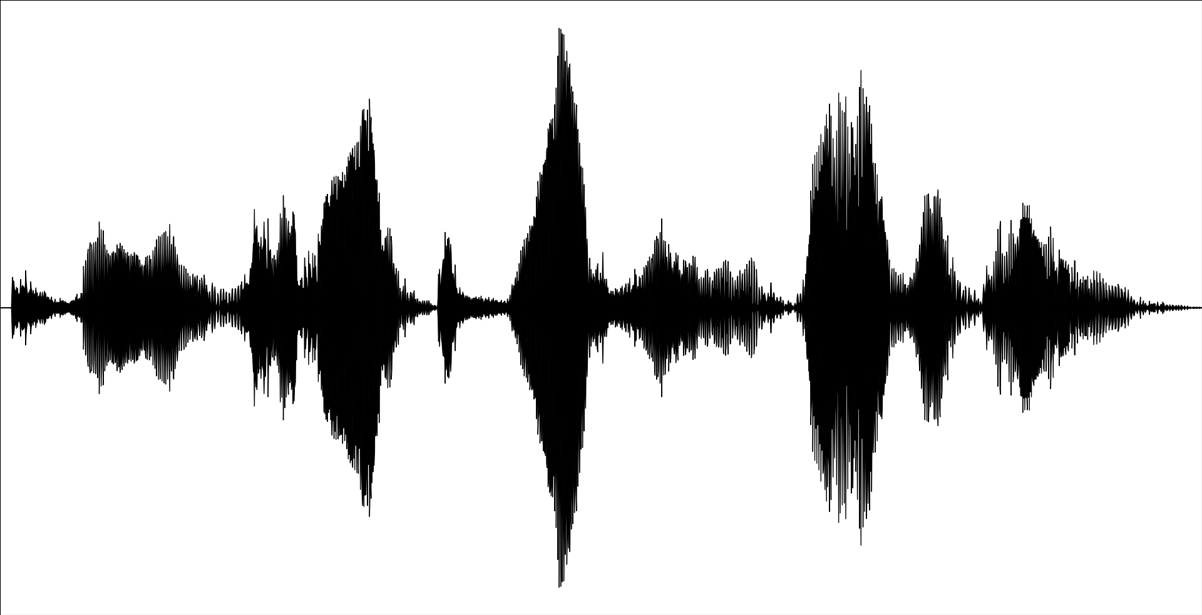
Preprocessing – Step 2. Cropped waveform

Slide 17
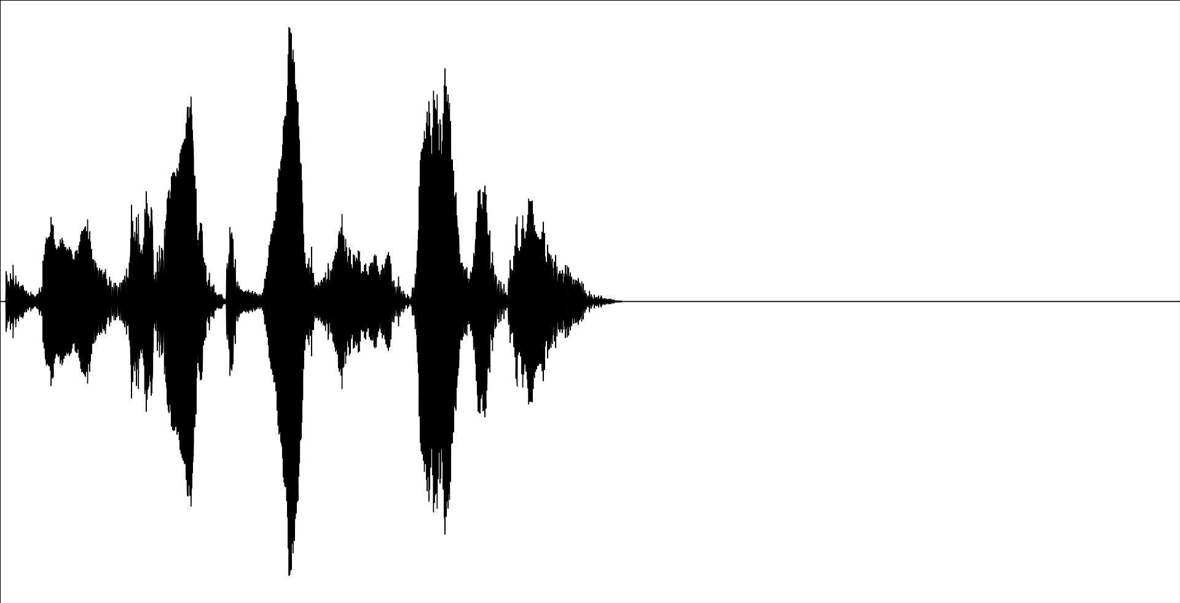
Preprocessing – Step 3. Padded waveform

Slide 18

Preprocessing – Step 4. Raw spectrogram

Slide 19
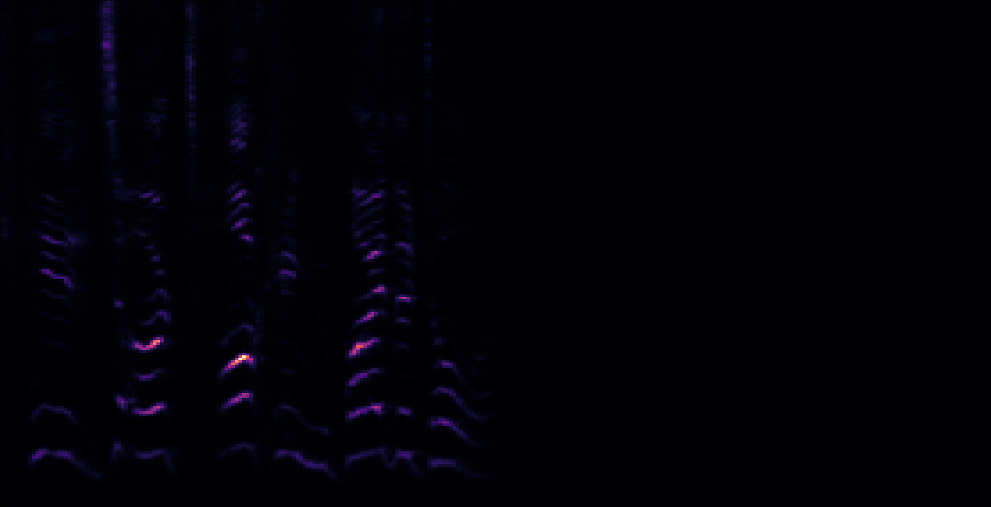
Preprocessing – Step 5. Mel spectrogram

Slide 20
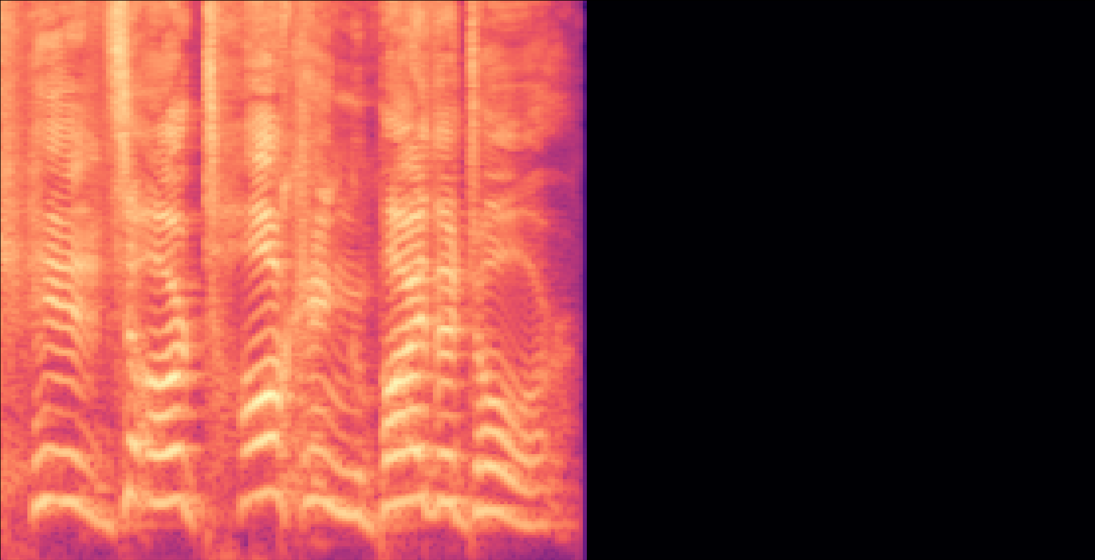
Preprocessing – Step 6. Log-Mel spectrogram

Slide 21
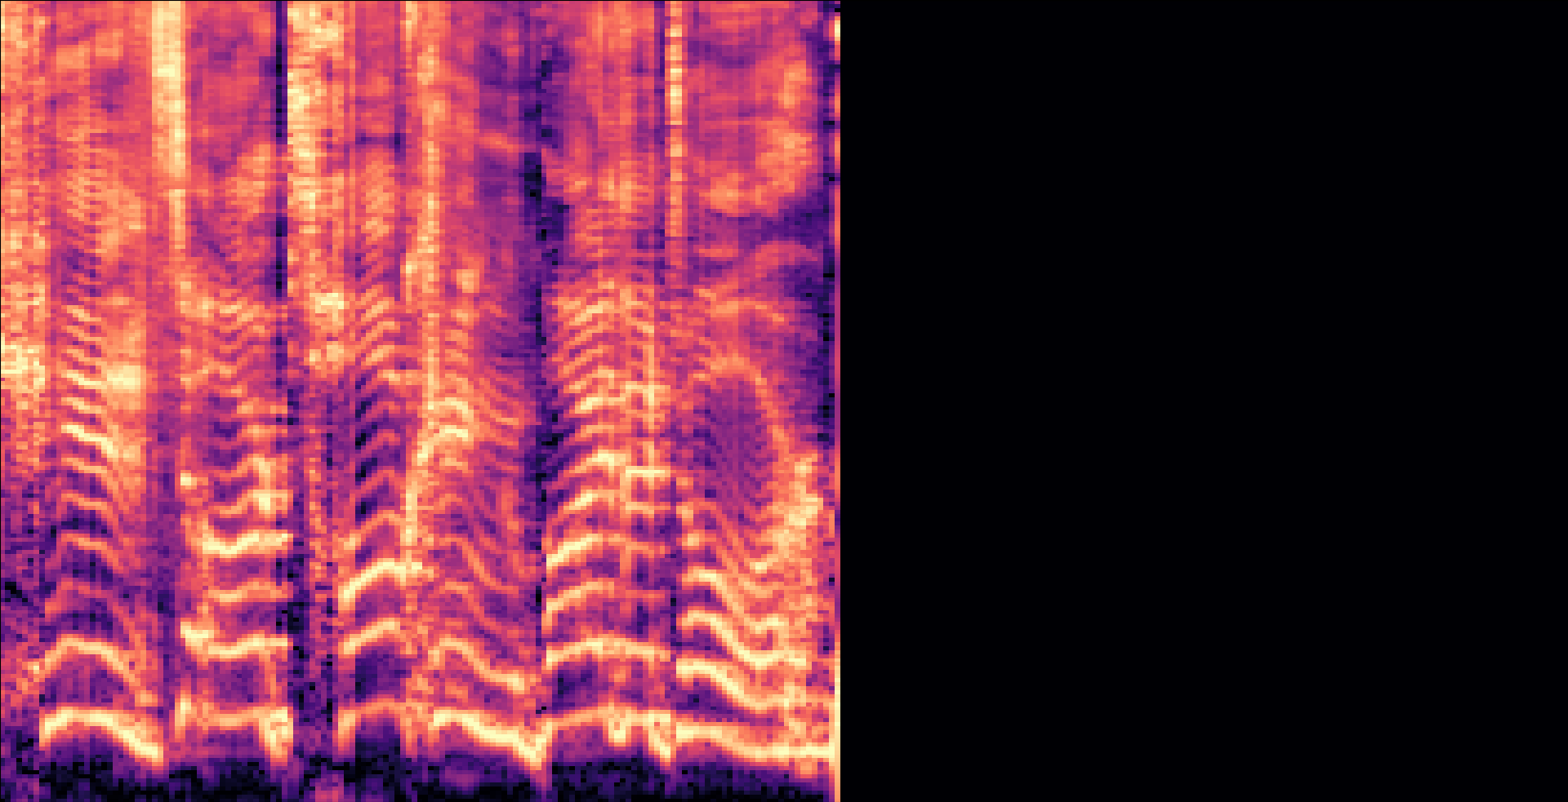
Preprocessing – Step 7. Scaled spectrogram

Slide 22
Table of Contents
Introduction
Literature Review
Summary of Results
Method
Preprocessing
Neural Network
Results and Discussion
Summary
Limitations and Future Work
Conclusion

Slide 23
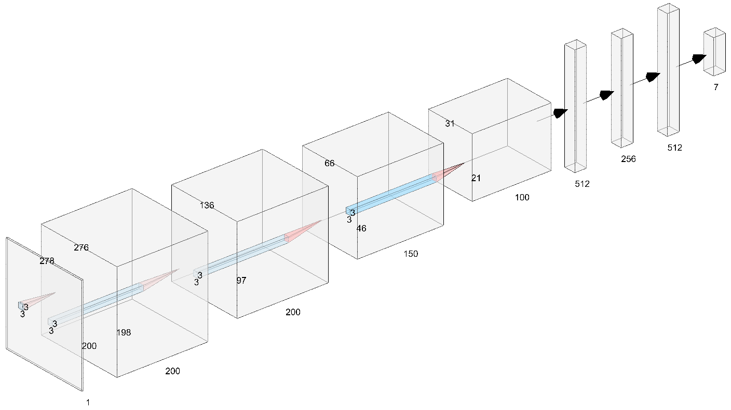
Neural Network – Architecture

Slide 24
Neural Network – Hyperparameters
Hyperparameter | Value
Input Dimensions | 278w x 200h x 1d
Optimization Algorithm | Adam
Loss Measure | Binary Cross-entropy
Accuracy Metric | Categorical Cross-entropy
Activation Function | Sigmoid
Epochs | 20
Batch Size | 32
Training Set | 17,341
Validation Set | 2,167
Testing Set | 2,167

Slide 25

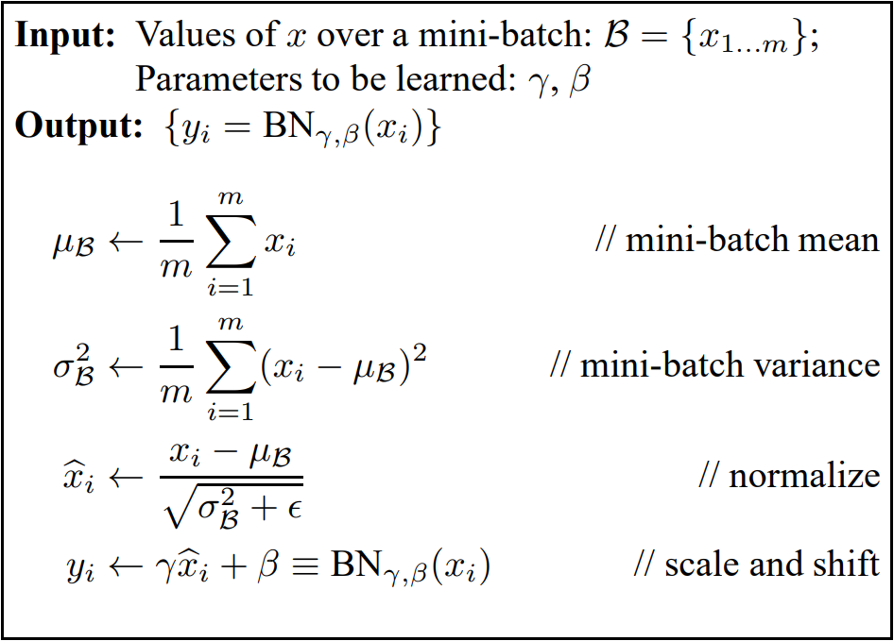
Neural Network – Anti-overfit Methods
Dropout on dense layers
Batch normalization on convolution layers

Slide 26
Table of Contents
Introduction
Literature Review
Summary of Results
Method
Preprocessing
Neural Network
Results and Discussion
Summary
Limitations and Future Work
Conclusion

Slide 27
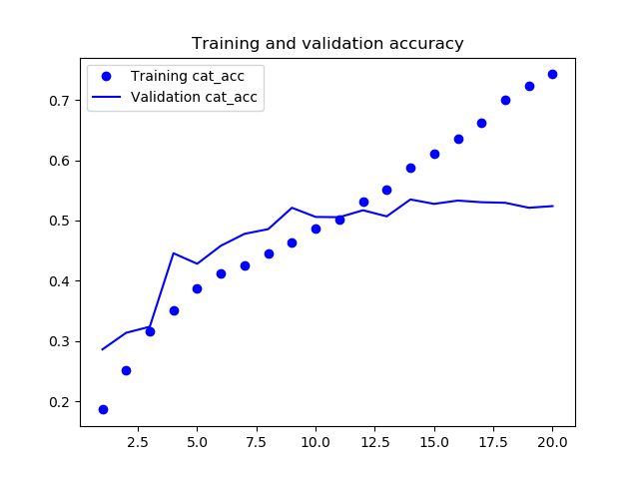
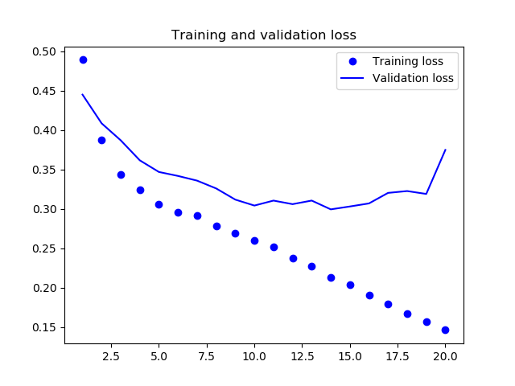
Summary – Neural Network Training
The accuracy training curve shows overfitting after 12 epochs.
Validation accuracy ends at about 53.91%.
The loss training curve also shows overfitting right from the start.
The lowest (best) loss is achieved at around epoch 18 before it rises.

Slide 28
The neural network achieves a final test accuracy of 52.57%.

Slide 29
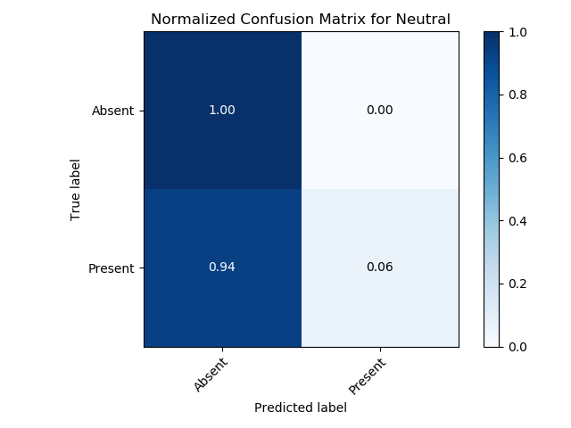
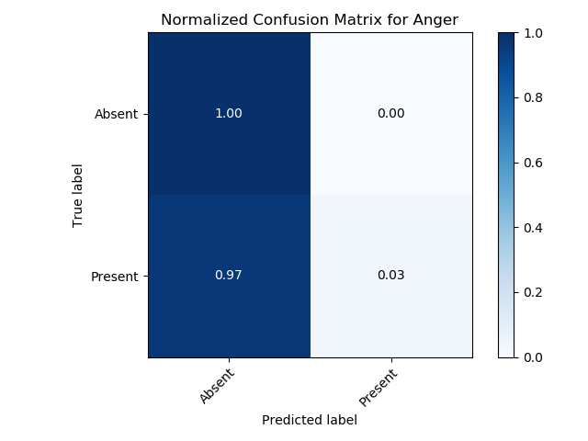
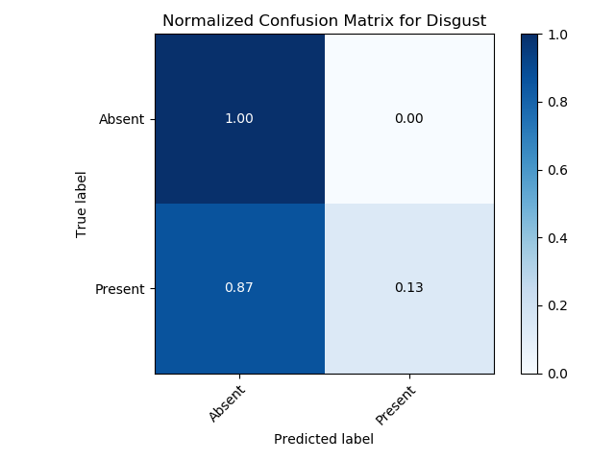
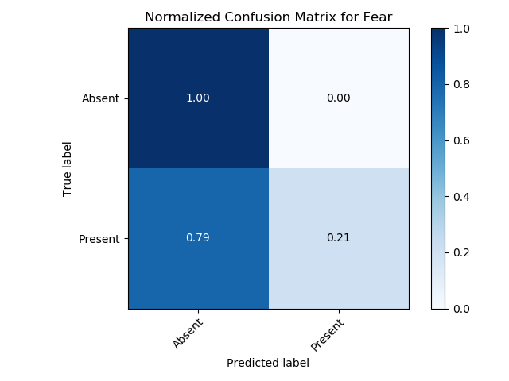


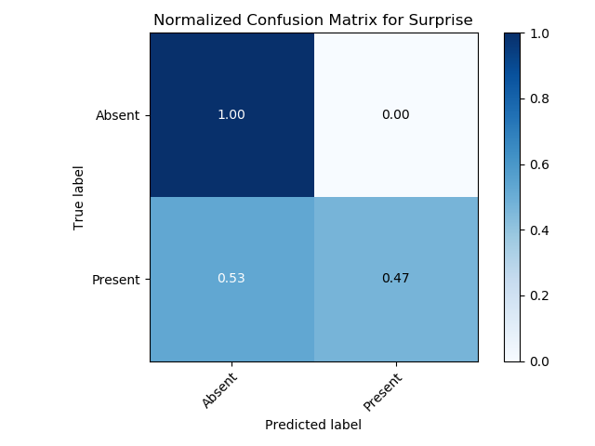
Summary – Confusion Matrices

Slide 30
Table of Contents
Introduction
Literature Review
Summary of Results
Method
Preprocessing
Neural Network
Results and Discussion
Summary
Limitations and Future Work
Conclusion

Slide 31
Limitations
Only considered seven emotions.
Accuracy could be better as the human baseline is around 70%.
Only considered samples in English.

Slide 32
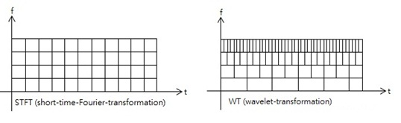
Future Work
Address the limitations.
Use phase data from spectrograms.
Wavelets.
Binary relevance.
Real-time emotion recognition.

Slide 33
Table of Contents
Introduction
Literature Review
Summary of Results
Method
Preprocessing
Neural Network
Results and Discussion
Summary
Limitations and Future Work
Conclusion

Slide 34
Conclusion
We applied machine learning to the problem of multi-class, multi-label speech emotion recognition.
We achieved an accuracy of 52.57%.
While this accuracy is a good start, we can do better by
Expanding the list of labeled emotions
Including the use of phase data from the STFT
Testing binary relevance against this problem

Slide 35
Acknowledgements
I would like to thank the following people for their support over the course of this research project
Thomas Truong
For providing technical advice and the project idea
Svetlana Yanushkevich
For providing lab space and the (expensive) GPUs for neural network training
Ethan Sengsavang
For coding up functions that I used and manually labeling the databases
I would also like to thank the Program for Undergraduate Research Experience (PURE) award for funding this research.

Slide 36
Thank You. Questions?
For more information, a paper will be released soon and the code is available at https://github.com/Brian-Pho/RVST598_Speech-Emotion-Recognition
Brian Pho
brian.pho@ucalgary.ca

Slide 37
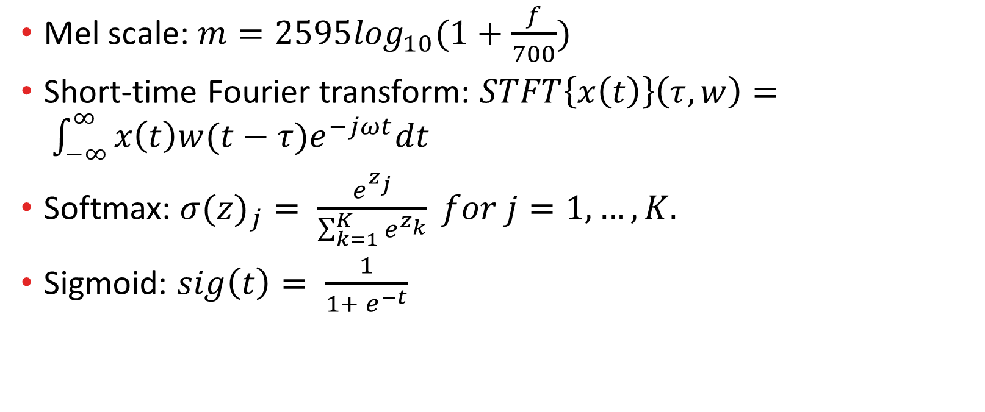
Appendix – Equations
Mel scale: $m=2595\log_{10}(1+\frac{f}{700})$
Short-time Fourier transform: $STFT\left\{x\left(t\right)\right\}\left(τ,w\right)= \int_{−∞}^{∞}{x\left(t\right)w(t−τ)e^{−jωt}dt}$
Softmax: ${σ(z)}_{j}= \frac{e^{z_{j}}}{\sum_{k=1}^{K}{e^{z_{k}}}} for j=1, …, K.$
Sigmoid: $sig\left(t\right)= \frac{1}{1+ e^{−t}}$

